Slide 1
AUTOMATIC WATERING SYSTEM FOR PLANTS
SUBMITTED BY,
SREELAKSHMI KRISHNANKUTTY – C0765644
GROUP - 6

Slide 2

IMPLEMENTATION OF POWER MANAGEMENT IN BEAGLEBONE BLACK

Slide 3
HARDWARE AND SOFTWARE REQUIREMENTS
BEAGLEBONE BLACK
PUTTY SOFTWARE

Slide 4
THE IMPORTANCE OF POWER MANAGEMENT
Power management is very important while doing a project.
Power management is used to improve efficiency of electric power usage
For the better power management, these techniques should be followed such as,
We have to make sure the minimum number of batteries is used in our project
Here, since we are using the beaglebone black, we can take an advantage of the SLEEP MODE of beagle bone black and save power.

Slide 5
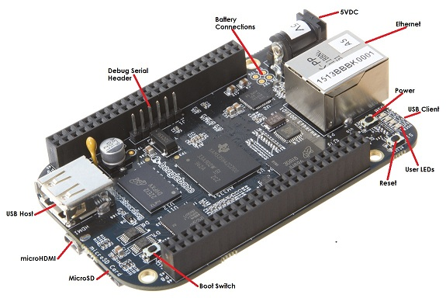
BEAGLEBONE BLACK
BeagleBone Black is a low-cost, community-supported development platform.
With just a single USB cable, you can boot Linux in under 10 seconds and get started developing in less than 5 minutes.
The BeagleBone Black is a small microprocessor and memory kit that aids in the operation of other embedded systems using the Linux operating system.
It's a system on a chip (SoC).

Slide 6
BEAGLEBONE BLACK
It is a small package containing anything that can be found on a computer or laptop. The BeagleBone black is like the standard BeagleBone, but it is quicker and has some additional features that make it more appealing.
The majority of engineers and developers choose to use it as a small network server and hub. At the production level, it's commonly used in automation, IoT, and robotics.

Slide 7
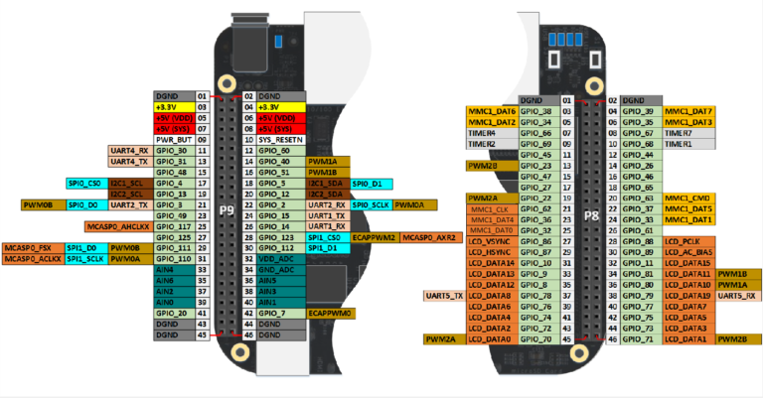
PIN CONFIGURATION DIAGRAM OF BEAGLEBONE BLACK

Slide 8
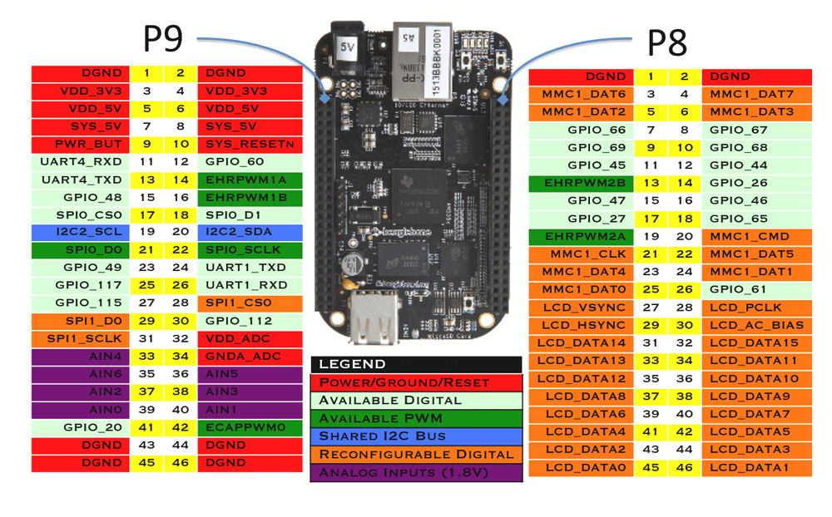
PIN CONFIGURATION
There are 65 digital pins on the expansion headers, which are also known as General-Purpose Input Output (GPIO) pins.

Slide 9
PIN CONFIGURATION
Some of the functionality that is available:
7 Analog pins
65 Digital Pins at 3.3V
2x I2C
2x SPI
2x CAN Bus
4 Timers
4x UART
8x PWM
A/D Converter

Slide 10
POWER SAVING WITH BEAGLEBONE
The am335x ARM chip in the BeagleBone Black has a Real Time Clock hidden inside that you can use to have the board spontaneously turn itself on anytime.
The ARM processor chip in the BBB has a Real Time Clock (RTC) built-in. This RTC has connections to the Power Management IC (PMIC) that it can use to tell the PMIC to either shut off the power or turn it back on.

Slide 11
POWER SAVING WITH BEAGLEBONE
There are two “alarms” in the RTC that we can set. When these alarms go off, one will send the signal to the PMIC telling it to turn off, and the other alarm tells the PMIC to turn the power on.
If the OFF bit on the PMIC is not set, the power to the ARM is only partially switched off, and there is a major difference between partially turned off and fully turned off. The PMIC continues to supply the very low-power LDO1 rail, which is connected directly to dedicated ARM pins that power the RTC in this state.

Slide 12
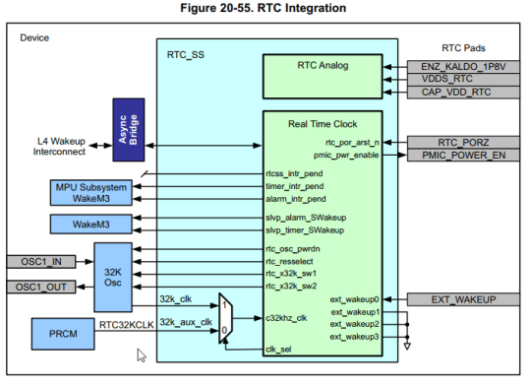
POWER SAVING WITH BEAGLEBONE
This part of the chip is special- it has its own special power supply connection so it stay running even when the rest of the chip is powered down.

Slide 13
POWER SAVING WITH BEAGLEBONE
On the BBB, it also has connections to the Power Management IC that can let it turn power off and on remotely. PMIC_POWER_EN is used to tell the PMIC to shutdown or turn on power…

Slide 14
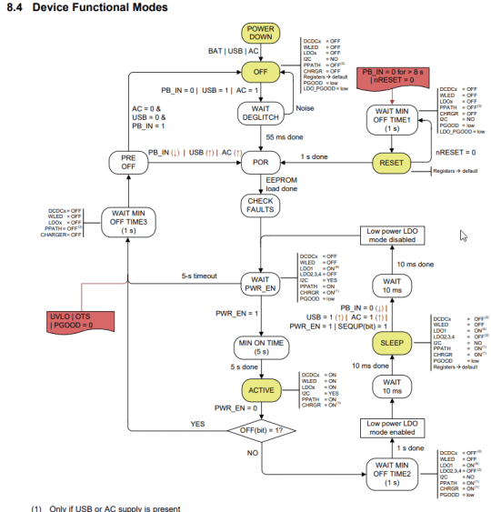
POWER SAVING WITH BEAGLEBONE
This diagram shows the
device functional modes.

Slide 15
POWER SAVING WITH BEAGLEBONE
If you look at the ACTIVE state, you can see we can get to SLEEP if OFF is 0 by setting PWR_EN to 0.
The sleep mode on the PMIC removes all power from the ARM except that special rail for the RTC.
OFF is a bit inside the PMIC chip, and we can set it to 0 over the i2c bus. The PMIC datasheet tells us that it is at address 0x24.

Slide 16
POWER SAVING WITH BEAGLEBONE
i2cset -f -y 0 0x24 0x0a 0x00 We need the -f because something in Linux is already using this i2c so we would get a busy error.
The RTC will make POWER_EN go low when ALARM2 goes off, and high when ALARM goes off if we set this bit.

Slide 17

SOFTWARE REQUIREMENTS
PUTTY
PuTTY is a terminal emulator, serial console, and network file transfer programme that is free and open-source.
SCP, SSH, Telnet, rlogin, and raw socket connections are among the network protocols it supports.
PuTTY can also be connected to a serial port.

Slide 18
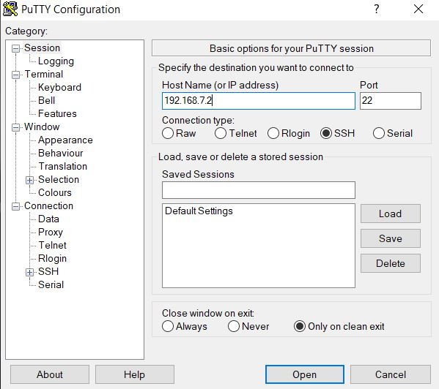
CONNECTING BEAGLEBONE BLACK VIA PUTTY SOFTWARE
Power the beaglebone black
SSH with windows and PuTTY
Enter the ip address 192.168.7.2 and then click open

Slide 19
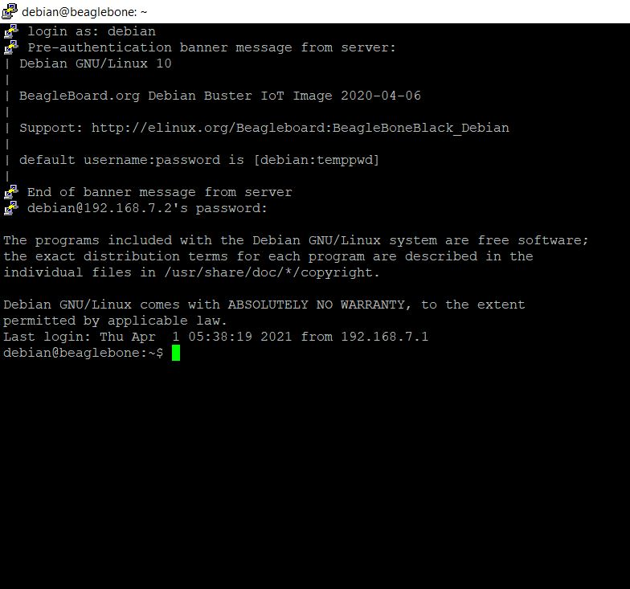
CONNECTING BEAGLEBONE BLACK VIA PUTTY SOFTWARE
After opening the PUTTY window, we have to login as Debian and then enter the password.

Slide 20
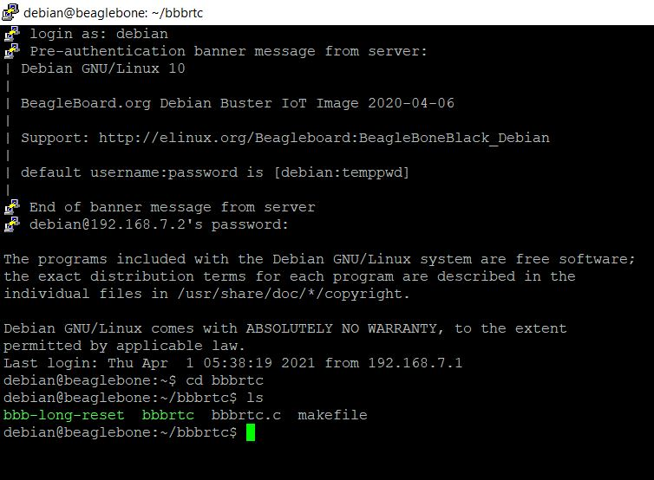
WORKING
We have to use the command cd bbbrtc
ie, the working directory that consist of the programs to make the beaglebone sleep and then wake back automatically
Then we use the command ls to list the files in the current working directory.

Slide 21
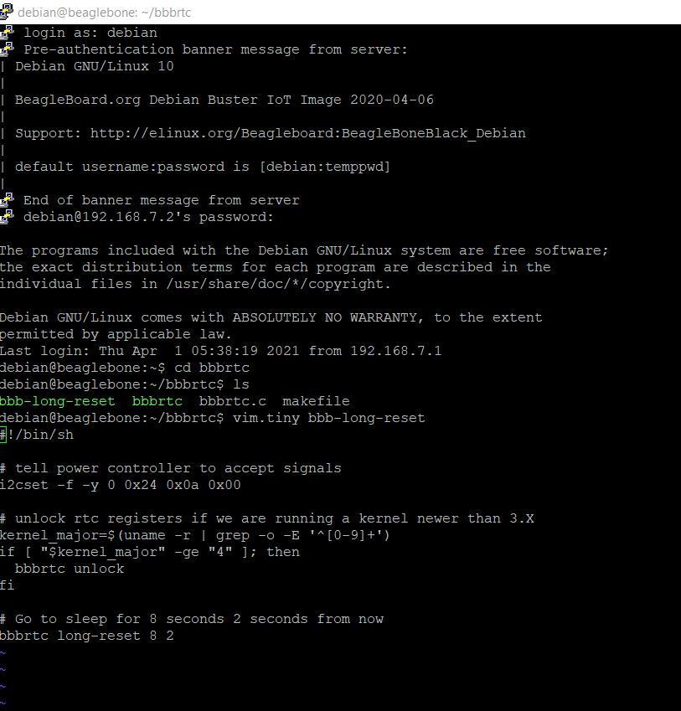
WORKING
Then we open the bbb-long-reset file using the command vim.tiny
That opens a shell script

Slide 22
WORKING
#!/bin/sh
# tell power controller to accept signals
i2cset -f -y 0 0x24 0x0a 0x00
# unlock rtc registers if we are running a kernel newer than 3.X
kernel_major=$(uname -r | grep -o -E '^[0-9]+')
if [ "$kernel_major" -ge "4" ]; then
bbbrtc unlock
fi
# Go to sleep for 8 seconds 2 seconds from now
bbbrtc long-reset 8 2
~

Slide 23
WORKING
Shell script is a programming language that uses linux commands.
The sleep mode is attained by controlling the PMIC module
So the PMIC and beaglebone are communicating through the i2c line.
Then by enabling the OFF bit in the internal register to wake the beaglebone from the sleep mode.
bbbrtc long-reset 8 2 : This command means a sleep mode of 8 seconds is given for the beaglebone starting 2 seconds from now.
After the 8 seconds beagle bone again wakes up.

Slide 24
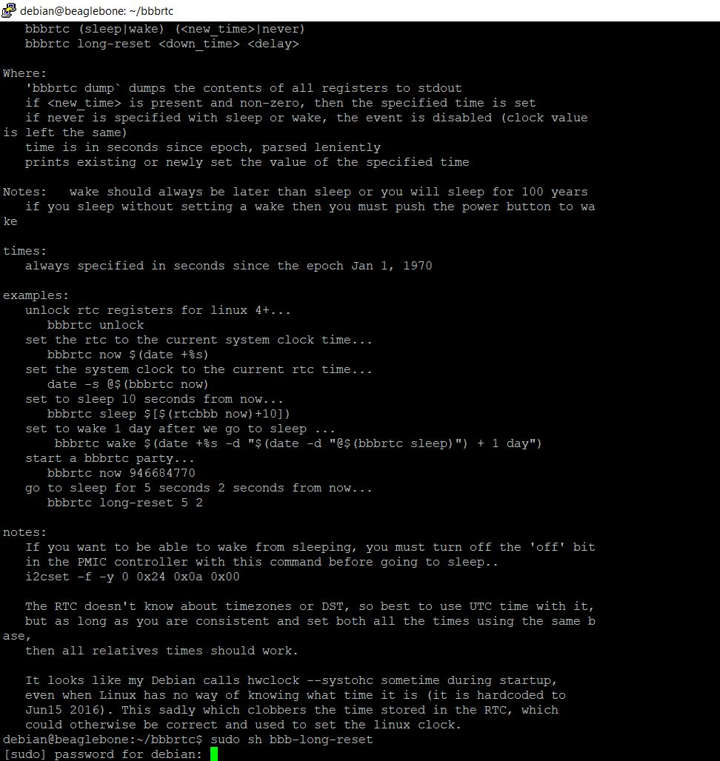
WORKING
Next, for implementing the sleep mode, we have to give the command sudo sh bbb-long-reset
Then enter the password

Slide 25
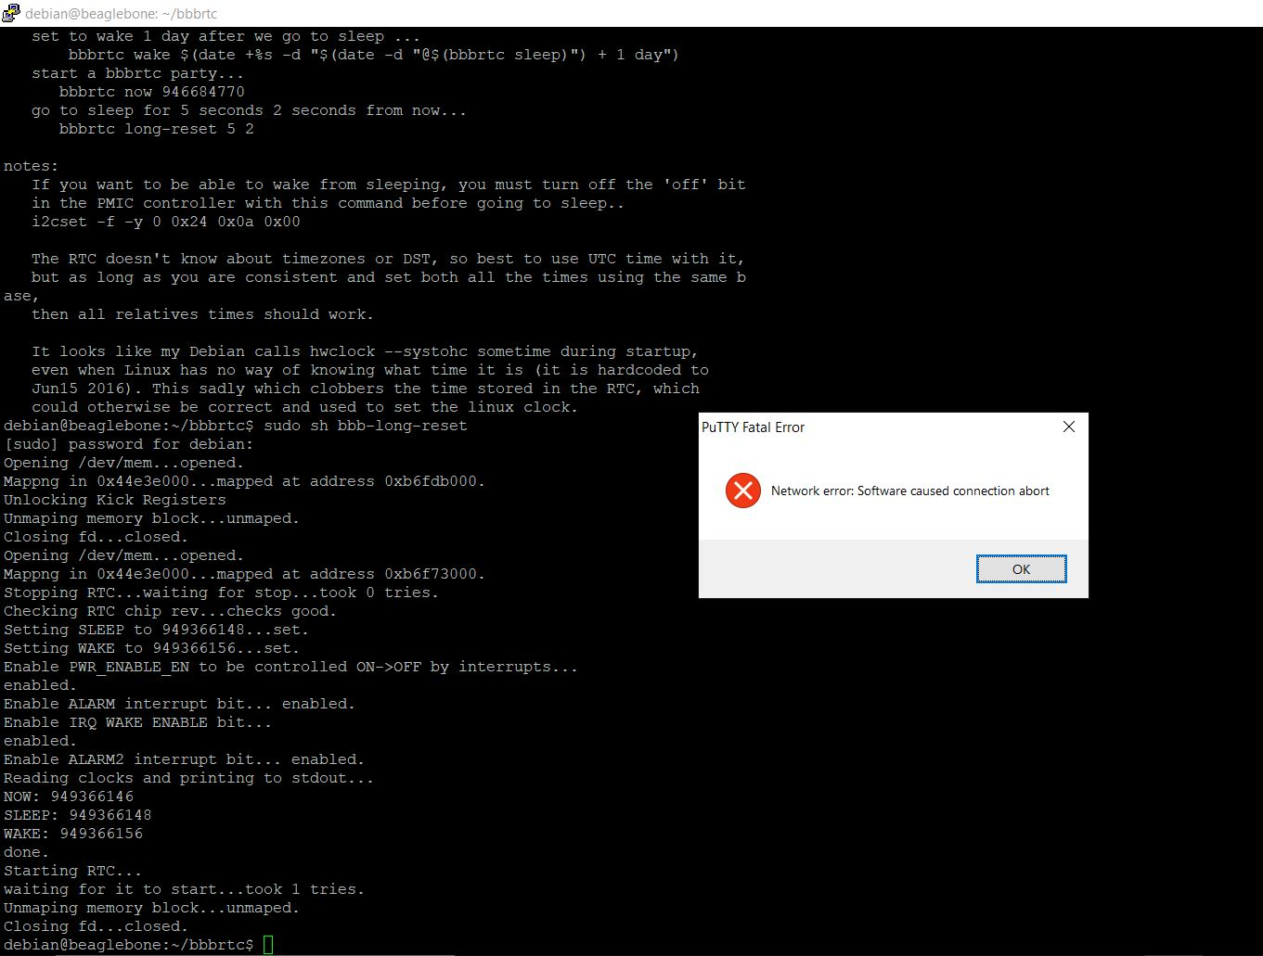
WORKING
After we run that previous command, the beaglebone black will go to sleepmode, showing this message.

Slide 26
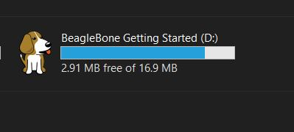
WORKING
Finally after 10 seconds, the beagle bone black will automatically come to power mode after sleep mode and will be ready again.

Slide 27
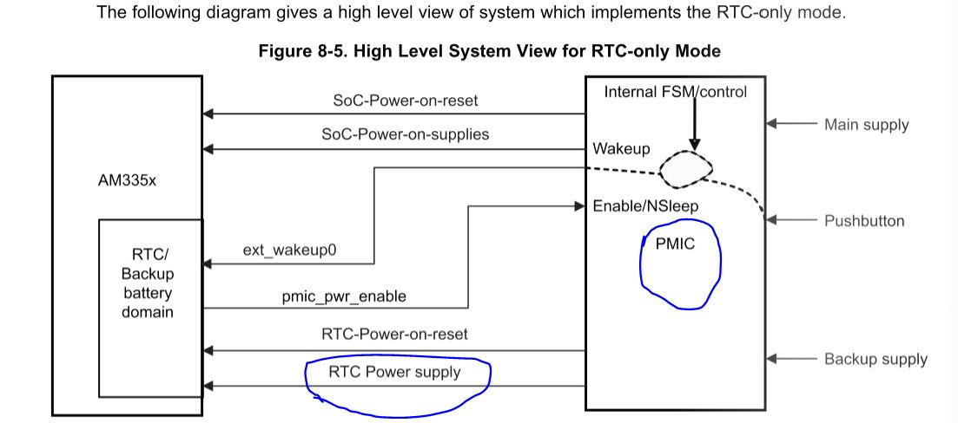
CONCLUSION
Inside the ARM chip of the board, on this board, there is a little real time clock (RTC) controller and it stays on even when the chip is powered down and it has its own power supply coming from the power management chip which keeps it running.

Slide 28
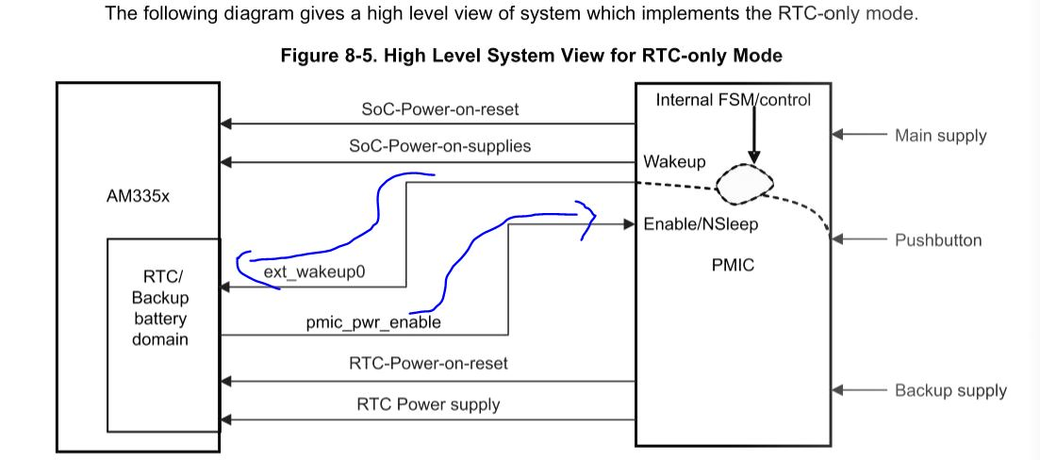
CONCLUSION
RTC clock has two signal lines that go to the power controller that set it OFF when you set a certain alarm and turn it ON when you set a different alarm.

Slide 29
REFERENCES
BBB FEATURES : https://microcontrollerslab.com/beaglebone-black-pinout-pin-configuration-features-applications/#:~:text=BeagleBone%20Black%20has%20two%20expansion,the%20board%20will%20be%20damaged.&text=Power%20output%3A%20Beagle%20Bone%20has,give%20powers%20to%20external%20devices.
Beagle bone turning itself on : https://wp.josh.com/2018/04/30/make-your-beaglebone-black-am355x-magically-turn-itself-on-with-the-built-in-alarm-clock/
High level system view RTC only mode : https://www.yumpu.com/en/document/read/18632049/chapter-08-power-reset-and-clock-management-prcmpdf

Slide 30

THANK YOU

